Slide 1
Global Vaccination Solution
Presented By:
Aman Kapoor
Satwik Kashyap
Harshad jaju

Slide 2
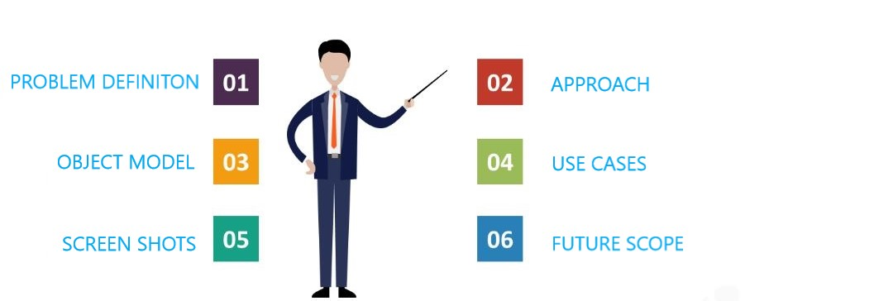
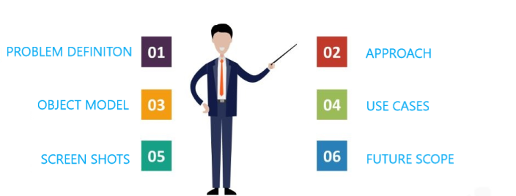
Content

Slide 3
Approach
PROBLEM DEFINITON
DESIGN
SPECIFICATION
IMPLEMENTATION

Slide 4
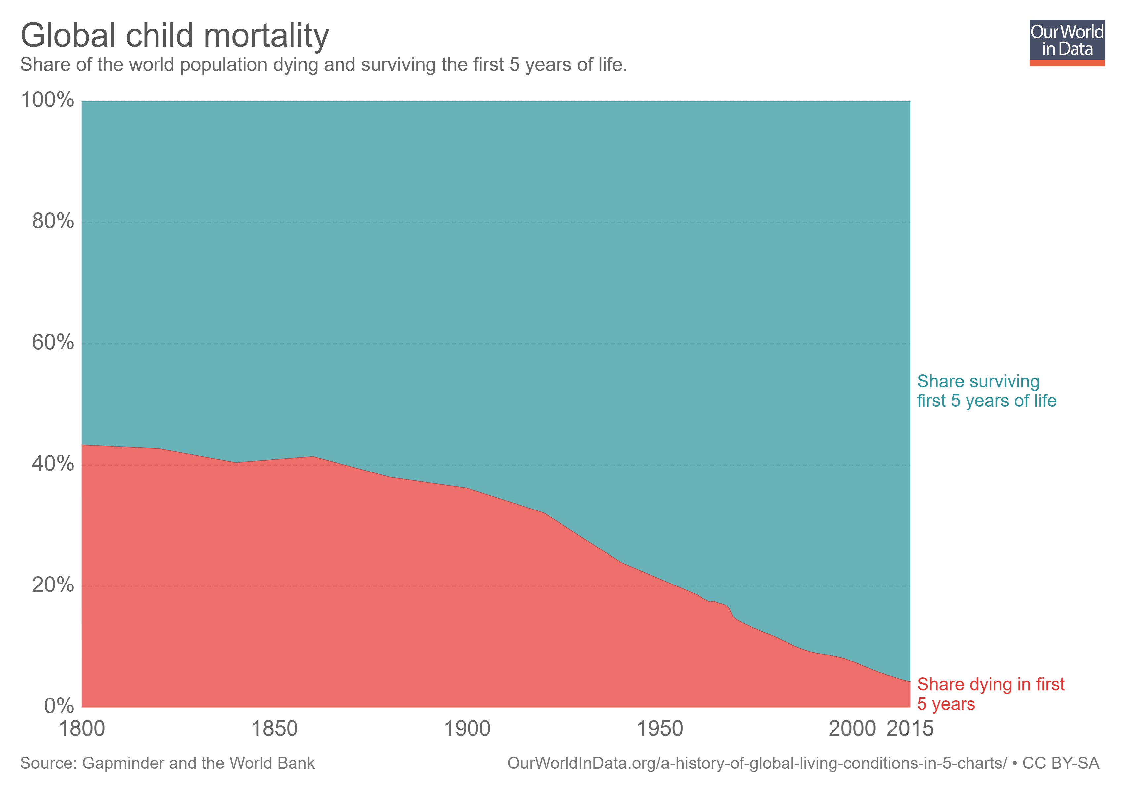
PROBLEM DEFINITION
- From 93 children of every 1,000 dying before age five and about 29,000 children under the age of five – 21 each minute – die every day, mainly from preventable causes.
- According to the WHO Reports, in 2015, nearly one in five infants –19.4 million children – missed out on the basic vaccines they need to stay healthy
- Vaccines keep children alive and healthy by protecting them against disease and if immunization is not prioritized, the most marginalized children will not get vaccines, which could mean the difference between life and death.
- Big countries like Brazil and China reduced their child mortality rates 10-fold over the last 4 decades. Other countries – especially in Africa – still have high child mortality rates

Slide 5
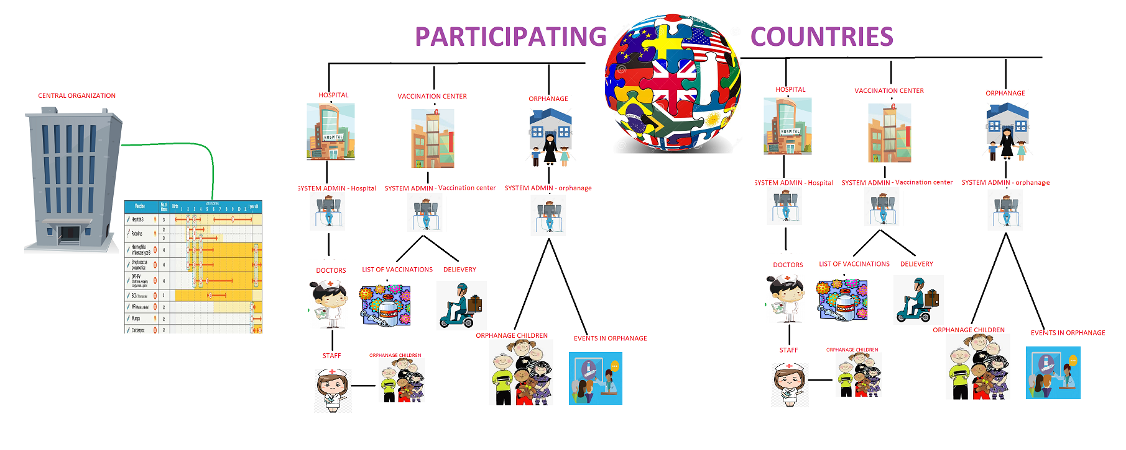
Model Components

Slide 6
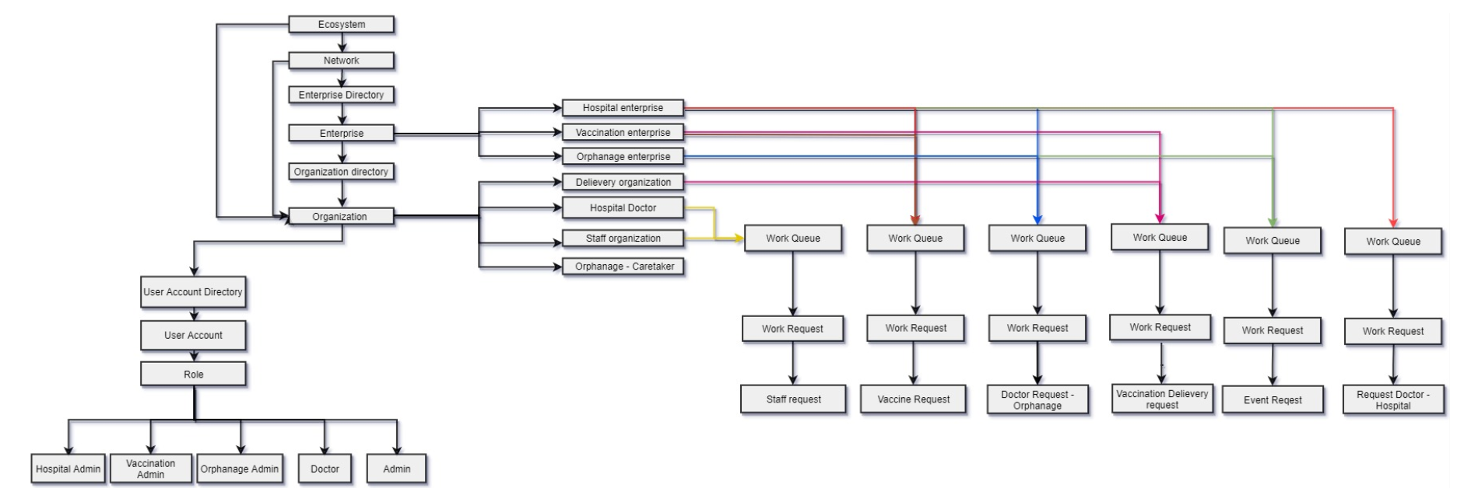
Object Model

Slide 7

Use Case 1 : Hospital should be able to request Vaccines across countries
Across Enterprise With in and OUT Network
Actors: Admin – Hospital , Admin – Vaccination
Purpose: To make vaccinations available to a hospital by sending vaccination request across various network (countries).
Work Flow: A Hospital in a particular country, if having shortage of vaccines could request vaccines from various vaccination centres across in and out network.

Slide 8
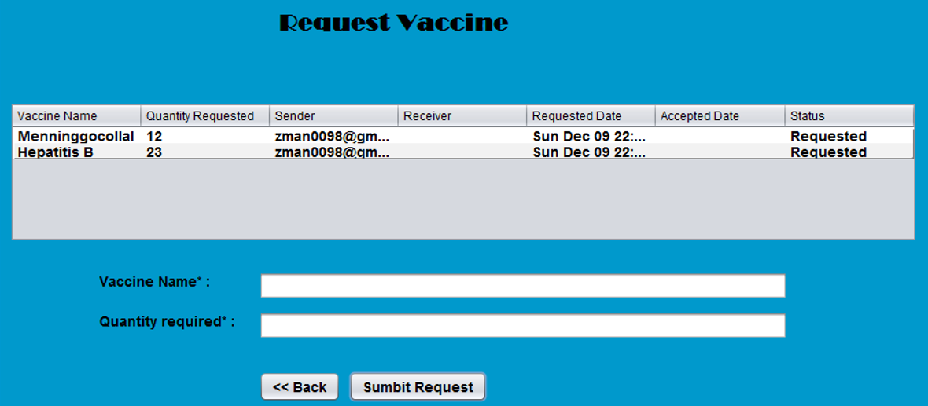
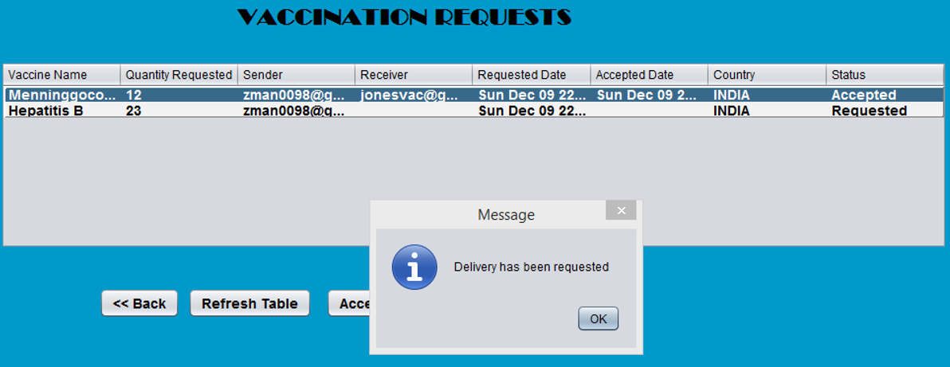
Request Across Network

Slide 9
Use Case 2 :Vaccination admin on approval would request the courier partners to full fill the request
Across Enterprise With in and OUT Network
Admin – Vaccination , Delivery Vendor
Purpose: To full fill the approved vaccination request for a hospital and making the vaccination reach on time with trusted courier partners across various network (countries).
Work Flow: A Vaccination department admin after accepting the request would request for delivery of the requested vaccines to the destined hospitals. The courier partners would receive the request and acknowledge the same with a given tentative date for delivery. An Email would be sent to be hospital once the courier partners acknowledges the request.

Slide 10
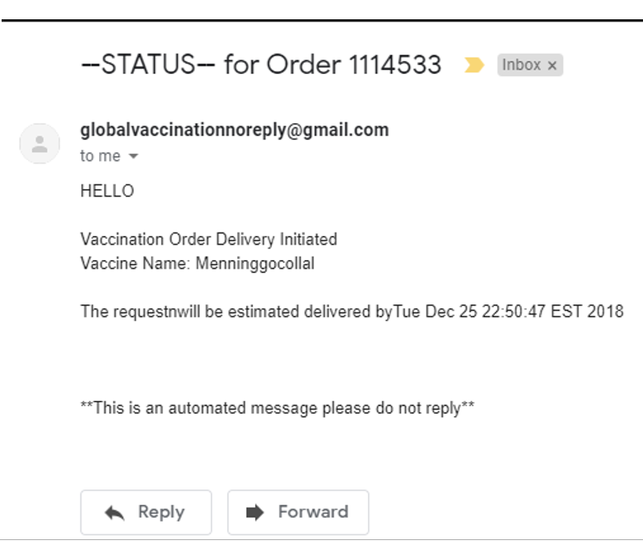
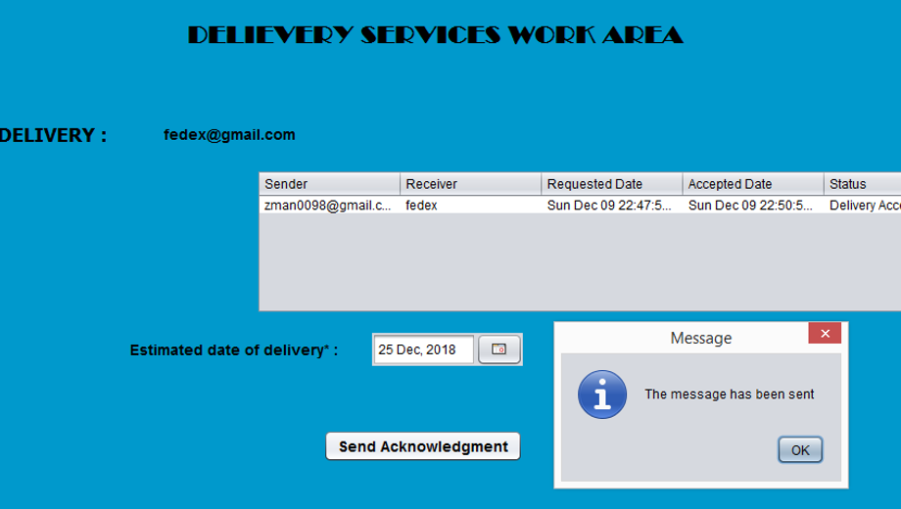
EMAIL to Hospital Admin

Slide 11
Use Case 3 : Hospital should be able to request Doctors
Across Enterprise With in and OUT Network
Actors: Admin – Hospital (in and out network)
Purpose: To make doctors available to a hospital who id a specialized domain expert across various network (countries).
Work Flow: A Hospital in a particular country, if having need for a specialized domain expert, could request doctors from various hospitals across in and out network.

Slide 12
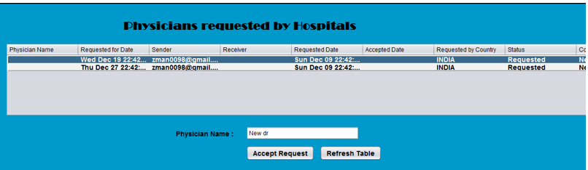

Slide 13
Use Case 4 :Hospital Organizing events in orphanage
Across Enterprise With in and OUT Network
Actors: Admin – Hospital , Admin – Orphanage
Purpose: To make timely health check-up and vaccinations for the children with keeping a track of it.
Work Flow: A Hospital, would be able organize events in orphanages with keeping the track of the children details with vaccination given. The hospital would provide a list of 3 event dates with orphanage choosing one depeing on the availability.

Slide 14
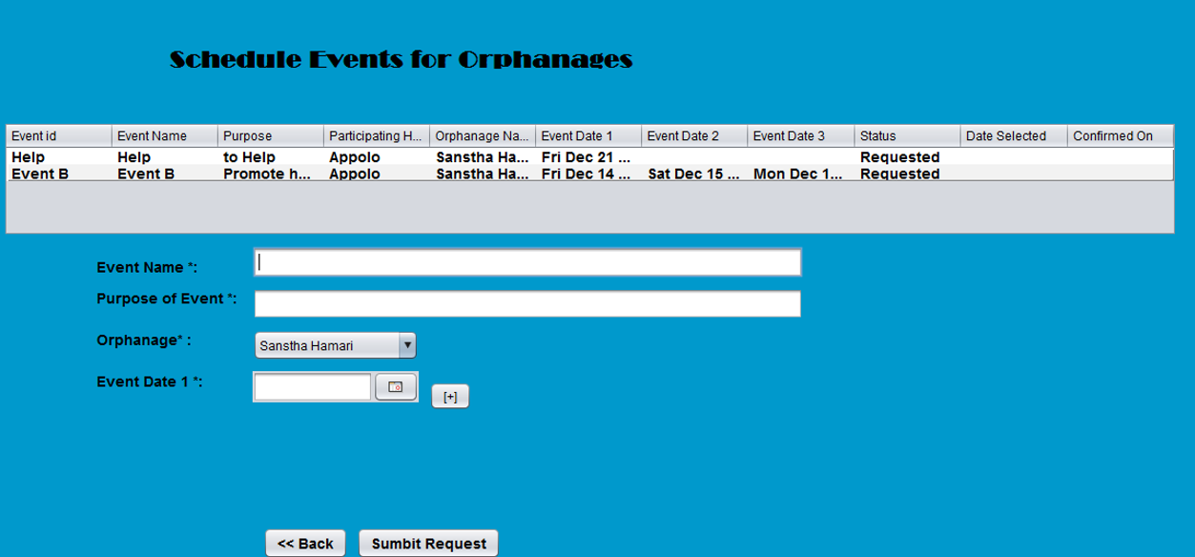
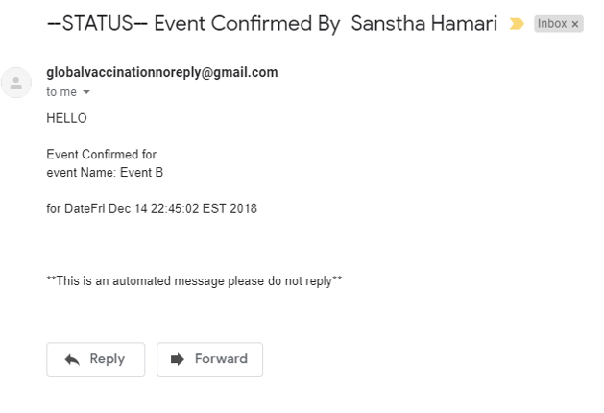
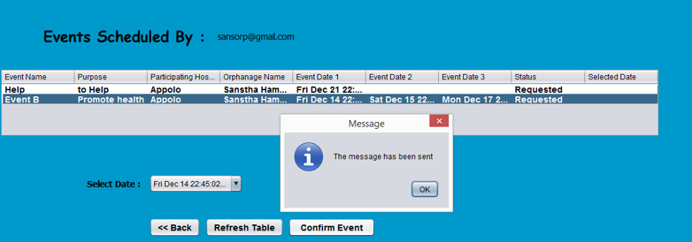

Slide 15
Use Case 5 : Doctors in Hospital should be able to request Staff
Across Enterprise With in and OUT Network
Actors: Doctor – Hospital , Staff – Hospital
Purpose: To make staff available to a doctor to accompany them during an orphanage visit, to help him across various activities.
Work Flow: A Doctor in a particular enterprise, if need to attend event in an orphanage could request staff from the staff organization.

Slide 16
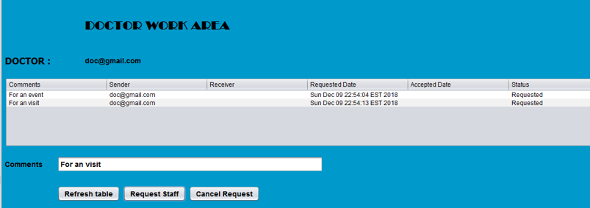
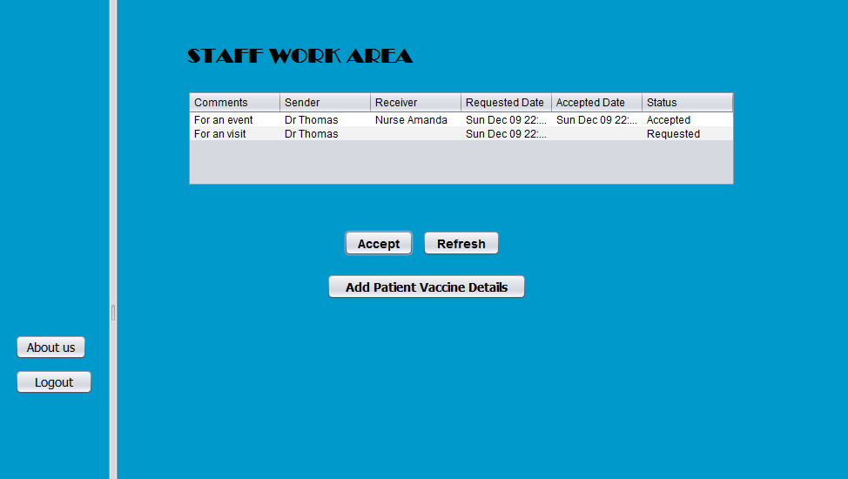
doctors and staff within the same enterprise

Slide 17
Use Case 6 : Staff of the hospital maintaining the directory for orphanage children
Across Enterprise With in and OUT Network
Actors: Staff – Hospital , Admin – Hospital
Purpose: To Track the details of the vaccine orphanage kids with the given vaccination name during a visit.
Work Flow: A Staff when accompanied by the doctor during the visit, would keep the list of students and their respective vaccination.

Slide 18
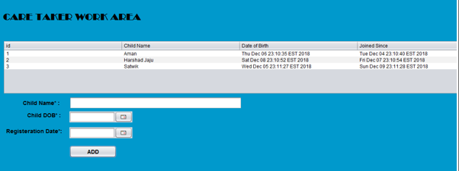

Slide 19
Use Case 7 : Orphanage requesting doctors
Across Enterprise With in and OUT Network
Actors: Admin – Orphanage , Admin – Hospital
Purpose: To help orphanage, if doctor is need for a child
Work Flow: A orphanage admin would initiate a need for doctor and once on availability of the doctor, an appointment would be scheduled with a confirmation email.

Slide 20
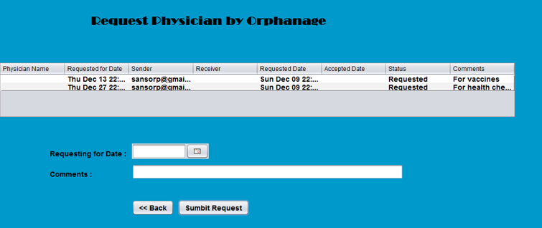
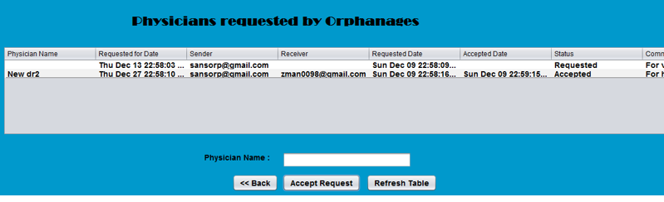

Slide 21
Thank You !!!

